Slide 1
Research Postgraduate (RPg) Education
@ HKU
@Faculty of Science

Slide 2
Student Enrolment@ HKU
Research postgraduate (RPg) students: ~3K (~10%)
MPhil and PhD Studies @ HKU
 |  | Full-time (Year) | Part-time (Year)
MPhil |  | 2 | 3
PhD | *3-year PhD | 3 | 4.5
 | 4-year PhD | 4 | 6
Admission Requirement for MPhil:
Bachelor’s degree with honours from HKU or comparable institution

Slide 3
MPhil and PhD Studies @ HKU
 |  | Full-time (Year) | Part-time (Year)
MPhil |  | 2 | 3
PhD | *3-year PhD | 3 | 4.5
 | 4-year PhD | 4 | 6
Admission Requirement for PhD: Bachelor’s degree (1st class Hons),
Bachelor’s degree (Hons) plus taught Master’s degree, or
Bachelor’s degree (Hons) plus MPhil*
from HKU or comparable institution

Slide 4
Funding RPg Education @ HKU
HKU Presidential PhD Scholarship (HKU-PS)
University
Postgraduate
Fellowship
(UPF)
Postgraduate
Scholarship
(PGS)
Tuition Waiver Scheme for Local Research Postgraduate (RPg) Students

Slide 5
HKU Presidential PhD Scholarship (HKU-PS)
The most prestigious package awarded to the brightest candidates applying for the full-time PhD programmes at HKU
Each President’s Scholar will receive a package of:
(a) Cash Award to support research and living expenses:
HK$40,000 in Year 1; HK$20,000 per year in the remaining normative study period
(b) Waiver of composition fees for the whole normative study period
(HK$42,100 per year)
*(c) Postgraduate Scholarship of HK$26,600 per month
*(d) Conference and Research-related Travel Allowance of HK$13,300 per year
(e) a guaranteed hall place in Year 1, with possibility of renewal in Year 1,
with possibility of renewal in Year 2
Full-time PhD applicants who have been nominated by the University to compete for the Hong Kong PhD Fellowship Scheme will be considered for HKU-PS.
Separate application for HKU-PS is not required.

Slide 6
HKPF is established by Hong Kong Research Grants Council
Awarded to new full-time PhD student with outstanding academic performance and research ability/potential
~300 HKPFs are granted each academic year
Package provided by the RGC (a period of 3 years)
Scholarship of HK$26,600 per month
Conference & research-related travel allowance of HK$13,300
Additional support from HKU
HKU Presidential PhD Scholarship (HKU-PS)
Additional support from Faculty of Science, HKU
Faculty’s Doctoral Entrance Award of HK$15,000 in Yr1
Application
Submit an online application through the RGC system
https://cerg1.ugc.edu.hk/hkpfs/apply.html
Notes:
Hong Kong PhD Fellowship Scheme
Established in 2009 by the Research Grants Council (RGC), the Hong Kong PhD Fellowship Scheme (HKPFS)
Applicants seeking admission as a new full-time PhD student in a Hong Kong university, are eligible to apply. HKPF is awarded to those who demonstrate outstanding academic performance, exceptional research ability/potential, acute communication and interpersonal skills, and excellent leadership abilities.
300 PhD Fellowships are granted in the 2021/22 academic year¹.
Awardees will each be entitled to an annual stipend of HK$319,200 (approximately US$40,900) and annual conference and research-related travel allowances of HK$13,300

Slide 7
University Postgraduate Fellowship (UPF)
A fellowship for full-time PhD applicants
A fellowship is at a total value of HK$70,000 on top of the Postgraduate Scholarship (PGS)
(Check the box “University Postgraduate Fellowships” in your application)
Postgraduate Scholarship (PGS)
A scholarship for full-time MPhil and PhD applicants
HK$18,030 per month (and HK$18,520 per month for PhD students whose probationary candidate has been confirmed
(Check the box “Postgraduate Scholarship” in your application)

Slide 8
MPhil and PhD Studies @ HKU
Tuition Fee
Study Mode | Tuition fee* (per year)
Full-time | HK$42,100
Part-time | HK$63,000
* Subject to revision

Slide 9
Accommodation
Full time non-local RPg students
A guaranteed hall place in Year 1

Slide 10
Application

Slide 11
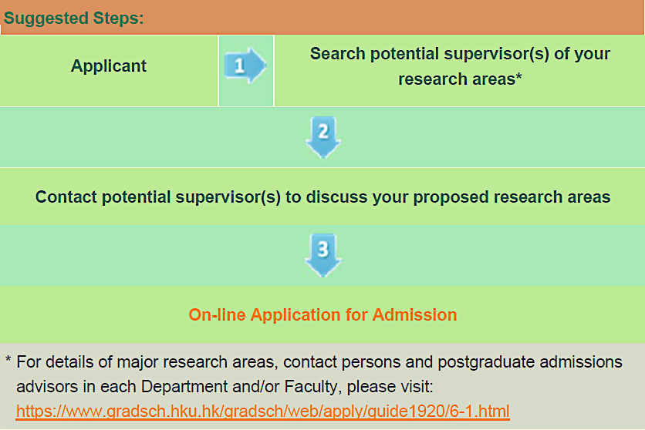
Application
https://www.gradsch.hku.hk/gradsch/programmes/area-of-interest

Slide 12
Application Dates
 | Application Dates
HKU Presidential PhD Scholarship (HKU-PS) * | Candidates who are nominated by HKU to the Research Grants Council to compete for the Hong Kong PhD Fellowship (HKPF) Scheme will be considered for HKU-PS. Separate application for HKU-PS is not required. Please see below for the application deadline for HKPF.
Hong Kong PhD Fellowship (HKPF) Scheme * | Initial Application to Research Grants Council (RGC): September 1, 2020 (HKT 12:00 nn or GMT +8 hours) – December 1, 2020 (HKT 12:00 or GMT +8 hours) Full Application to HKU: September 1, 2020– December 1, 2020 (HKT 23:59 or GMT +8 hours)
Main Round | December 1, 2020
1st Clearing Round | April 30, 2021
2nd Clearing Round | August 31, 2021

